Slide 1
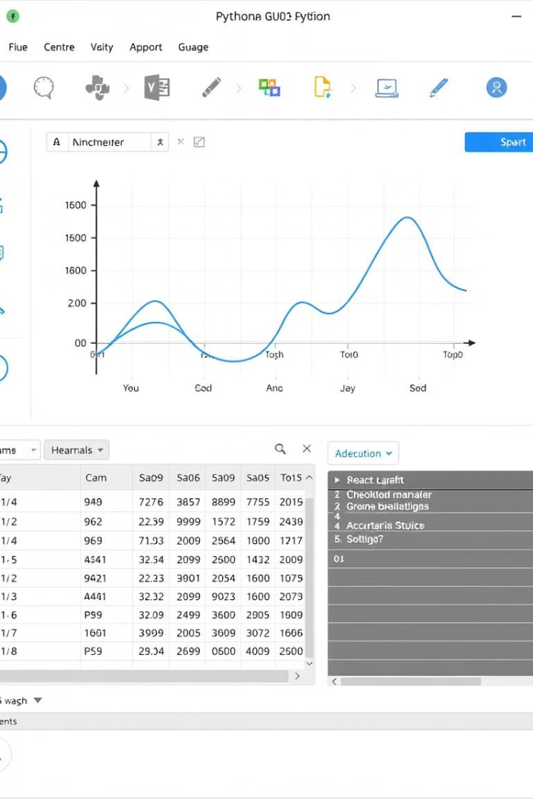
Python GUI Programming
Explore Python GUI programming to create interactive desktop applications.
Unlock the potential of user-friendly interfaces with Python.
ps
by prem shah

Slide 2
Popular GUI Frameworks
Tkinter
PyQt
Kivy
wxPython
Simple, built-in, cross-platform, but limited features.
Extensive features, cross-platform, but complex API.
Multi-touch support, modern UI, steep learning curve.
Native look and feel, comprehensive, large codebase.

Slide 3
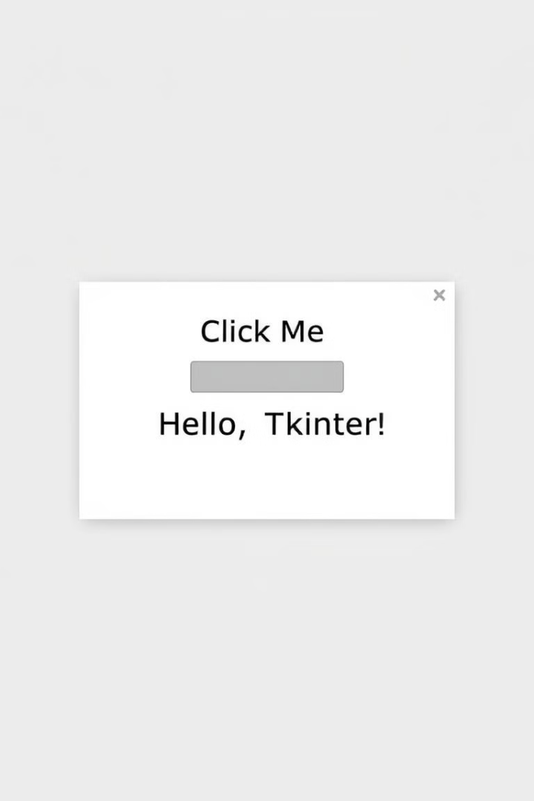
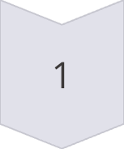
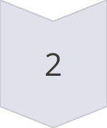
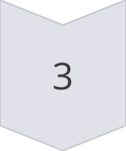
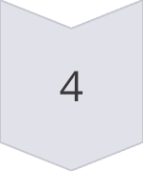
Getting Started with Tkinter
Import tkinter
Start by importing the necessary module.
Create a window
Instantiate the main application window.
Add widgets
Include labels, buttons, and other elements.
Run mainloop
Start the event loop to display the GUI.

Slide 4
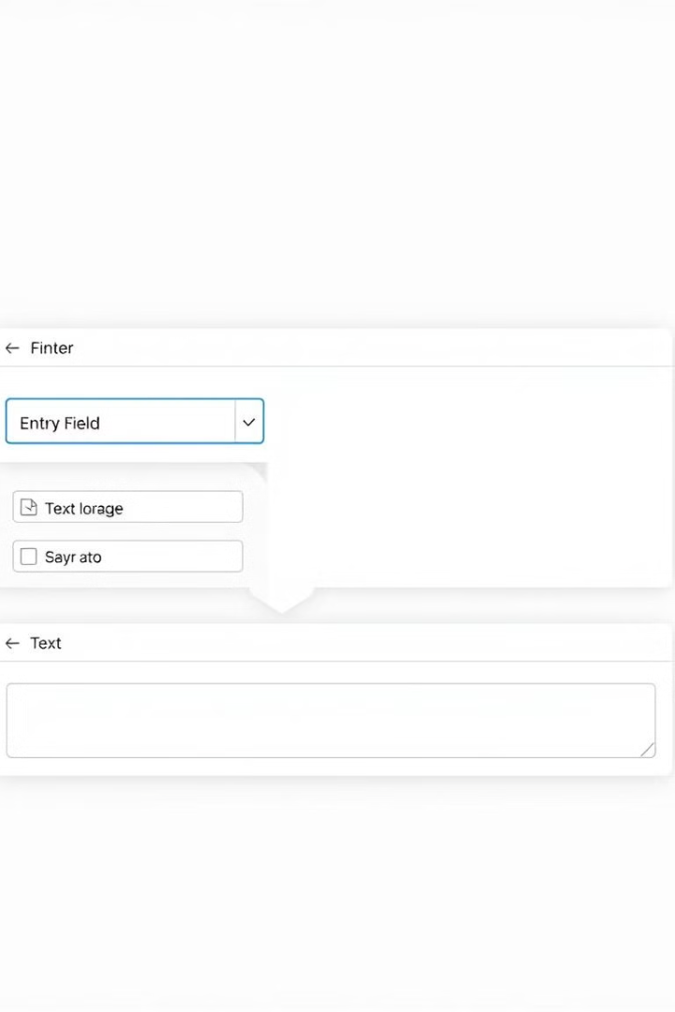



Common Tkinter Widgets
Entry Fields
Checkboxes
Text Areas
Enable text input.
Provide boolean options.
Support multi-line text.

Slide 5
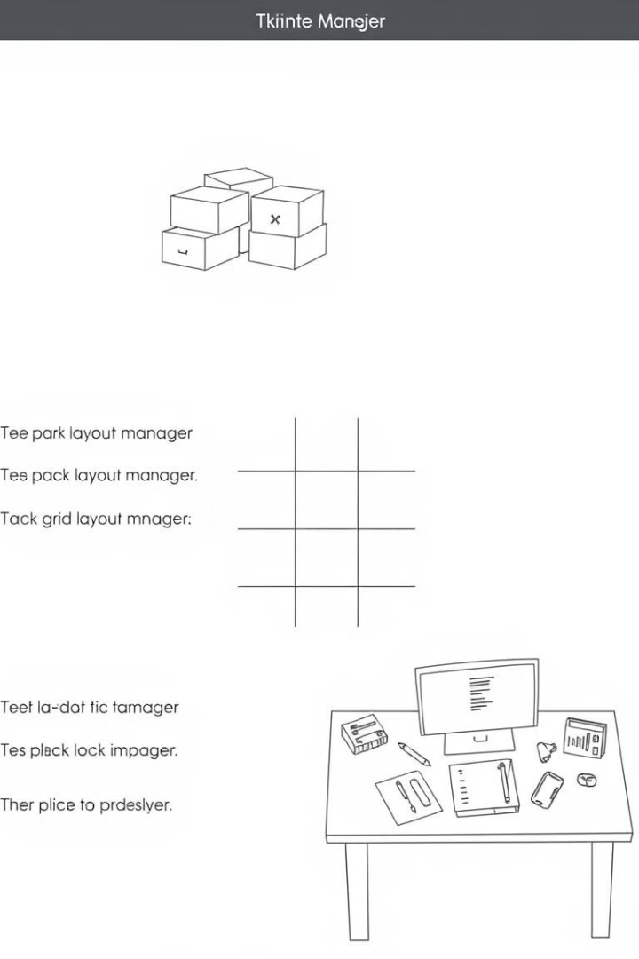
Layout Management in Tkinter
pack()
grid()
Simple layout, can be inflexible.
Table-like, precise control.
place()
Absolute positioning, less common.

Slide 6
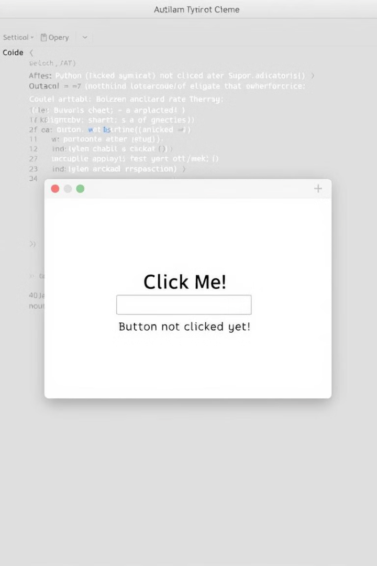



Event Handling in Tkinter
Bind events to widgets.
Define functions for events.
Create dynamic interfaces.

Slide 7
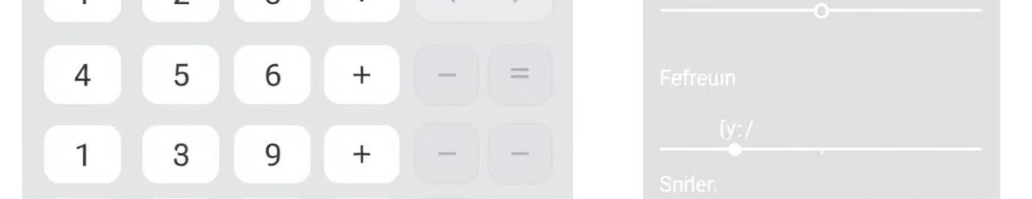
Building a Simple GUI Application
1
Define Window
2
Add Widgets
3
Handle Events
Create the main window.
Include buttons and labels.
Connect button clicks to functions.

Slide 8
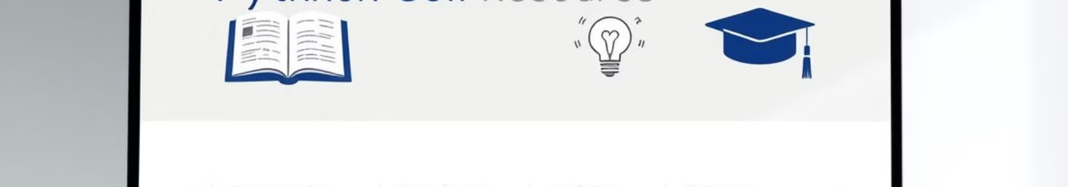



Conclusion and Resources
Official
Tkinter documentation.
Online
Learn GUI courses.
Community
Get Help online.

